Slide 1
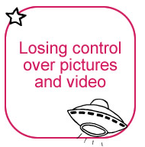
What is Sexting?
Someone taking an indecent image of themselves, and sending it to their friends or boy/girlfriend via a mobile phone or some other form of technology is sometimes referred to as ‘sexting’.

Slide 2
Sexting Consequences
Once taken and sent to others young people could lose control of the image. It could be seen by:
Family and friends
Future employers
A police officer
Collected by:
Offenders
The sharing of sexual imagery may make a child vulnerable to bullying and harassment.

Slide 3

Is sexting Illegal?
In the eyes of the law ‘Sexting’ is illegal.
It is important that you are aware of the possible consequences and its seriousness.
If you send an image you lose control of it forever and you have no control over who sees it.
If you send an image someone has sent you it is illegal.
THINK
It could cost you a college placement, interview or your job!!

Slide 4
Sexting
Show the CEOP’s Exposed Video
Staff Shared/Pastoral/Ceops

