Slide 1
Social Network and Media Sites
Think about your Safety
Security settings need to be set to “Friends only”, that includes - comments, posts and photos
These “Friends” need to be people you know and trust in the real world
Content - Only post content and photos you wouldn't mind showing your parents!
Try your very best to be “Responsible” when you use Facebook
Do you know how to report an issue directly to Facebook?

Slide 2
Social Network and Media Sites
Remember the online World is REAL and can be dangerous.
You are not invisible or invincible.
Do not have contact with people you do not know.
If a person makes sexual comments or innuendo tell someone.
Never meet anyone you do not know!
Do not take unnecessary risks.

Slide 3
Social Network and Media Sites
Think about your future and how you want to be viewed.
Lots of employers and colleges are now asking for permission to look at your profile. Why would you say no?
If you say no what will they think?

Slide 4
Social Network and Media Sites
THE WORLD IS CHANGING!
What does your DIGITAL FOOTPRINT say about you?
It could cost you a college place, an interview or your job!
Don’t think it doesn’t happen!! IT DOES!!

Slide 5
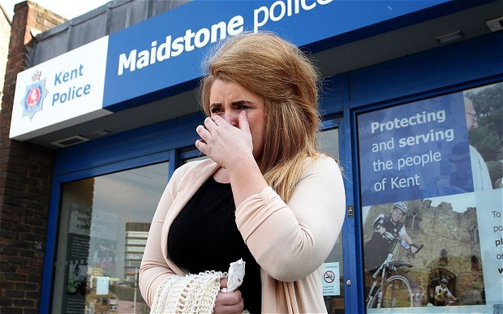
Social Network and Media Sites
The UK's first youth police and crime commissioner, Paris Brown, has resigned from her post following criticism of messages she posted on Twitter.
In a statement, the teenager, from Sheerness, said: "I accept that I have made comments on social networking sites which have offended many people and I am really, truly sorry for any offence that has been caused.
She added: "I have fallen into the trap of behaving with bravado on social networking sites. I hope that this stands as a learning experience for many other young people."
She was 14 when she made racist and homophobic comments.

